Slide 1

OLSAT MONITORING SYSTEM
Del rosario, pingoy, recierdo, velarde

Slide 2

OLSAT MONITORING SYSTEM
Dashboard
Student Section
Monitoring Section
Upload CSV file

Slide 3
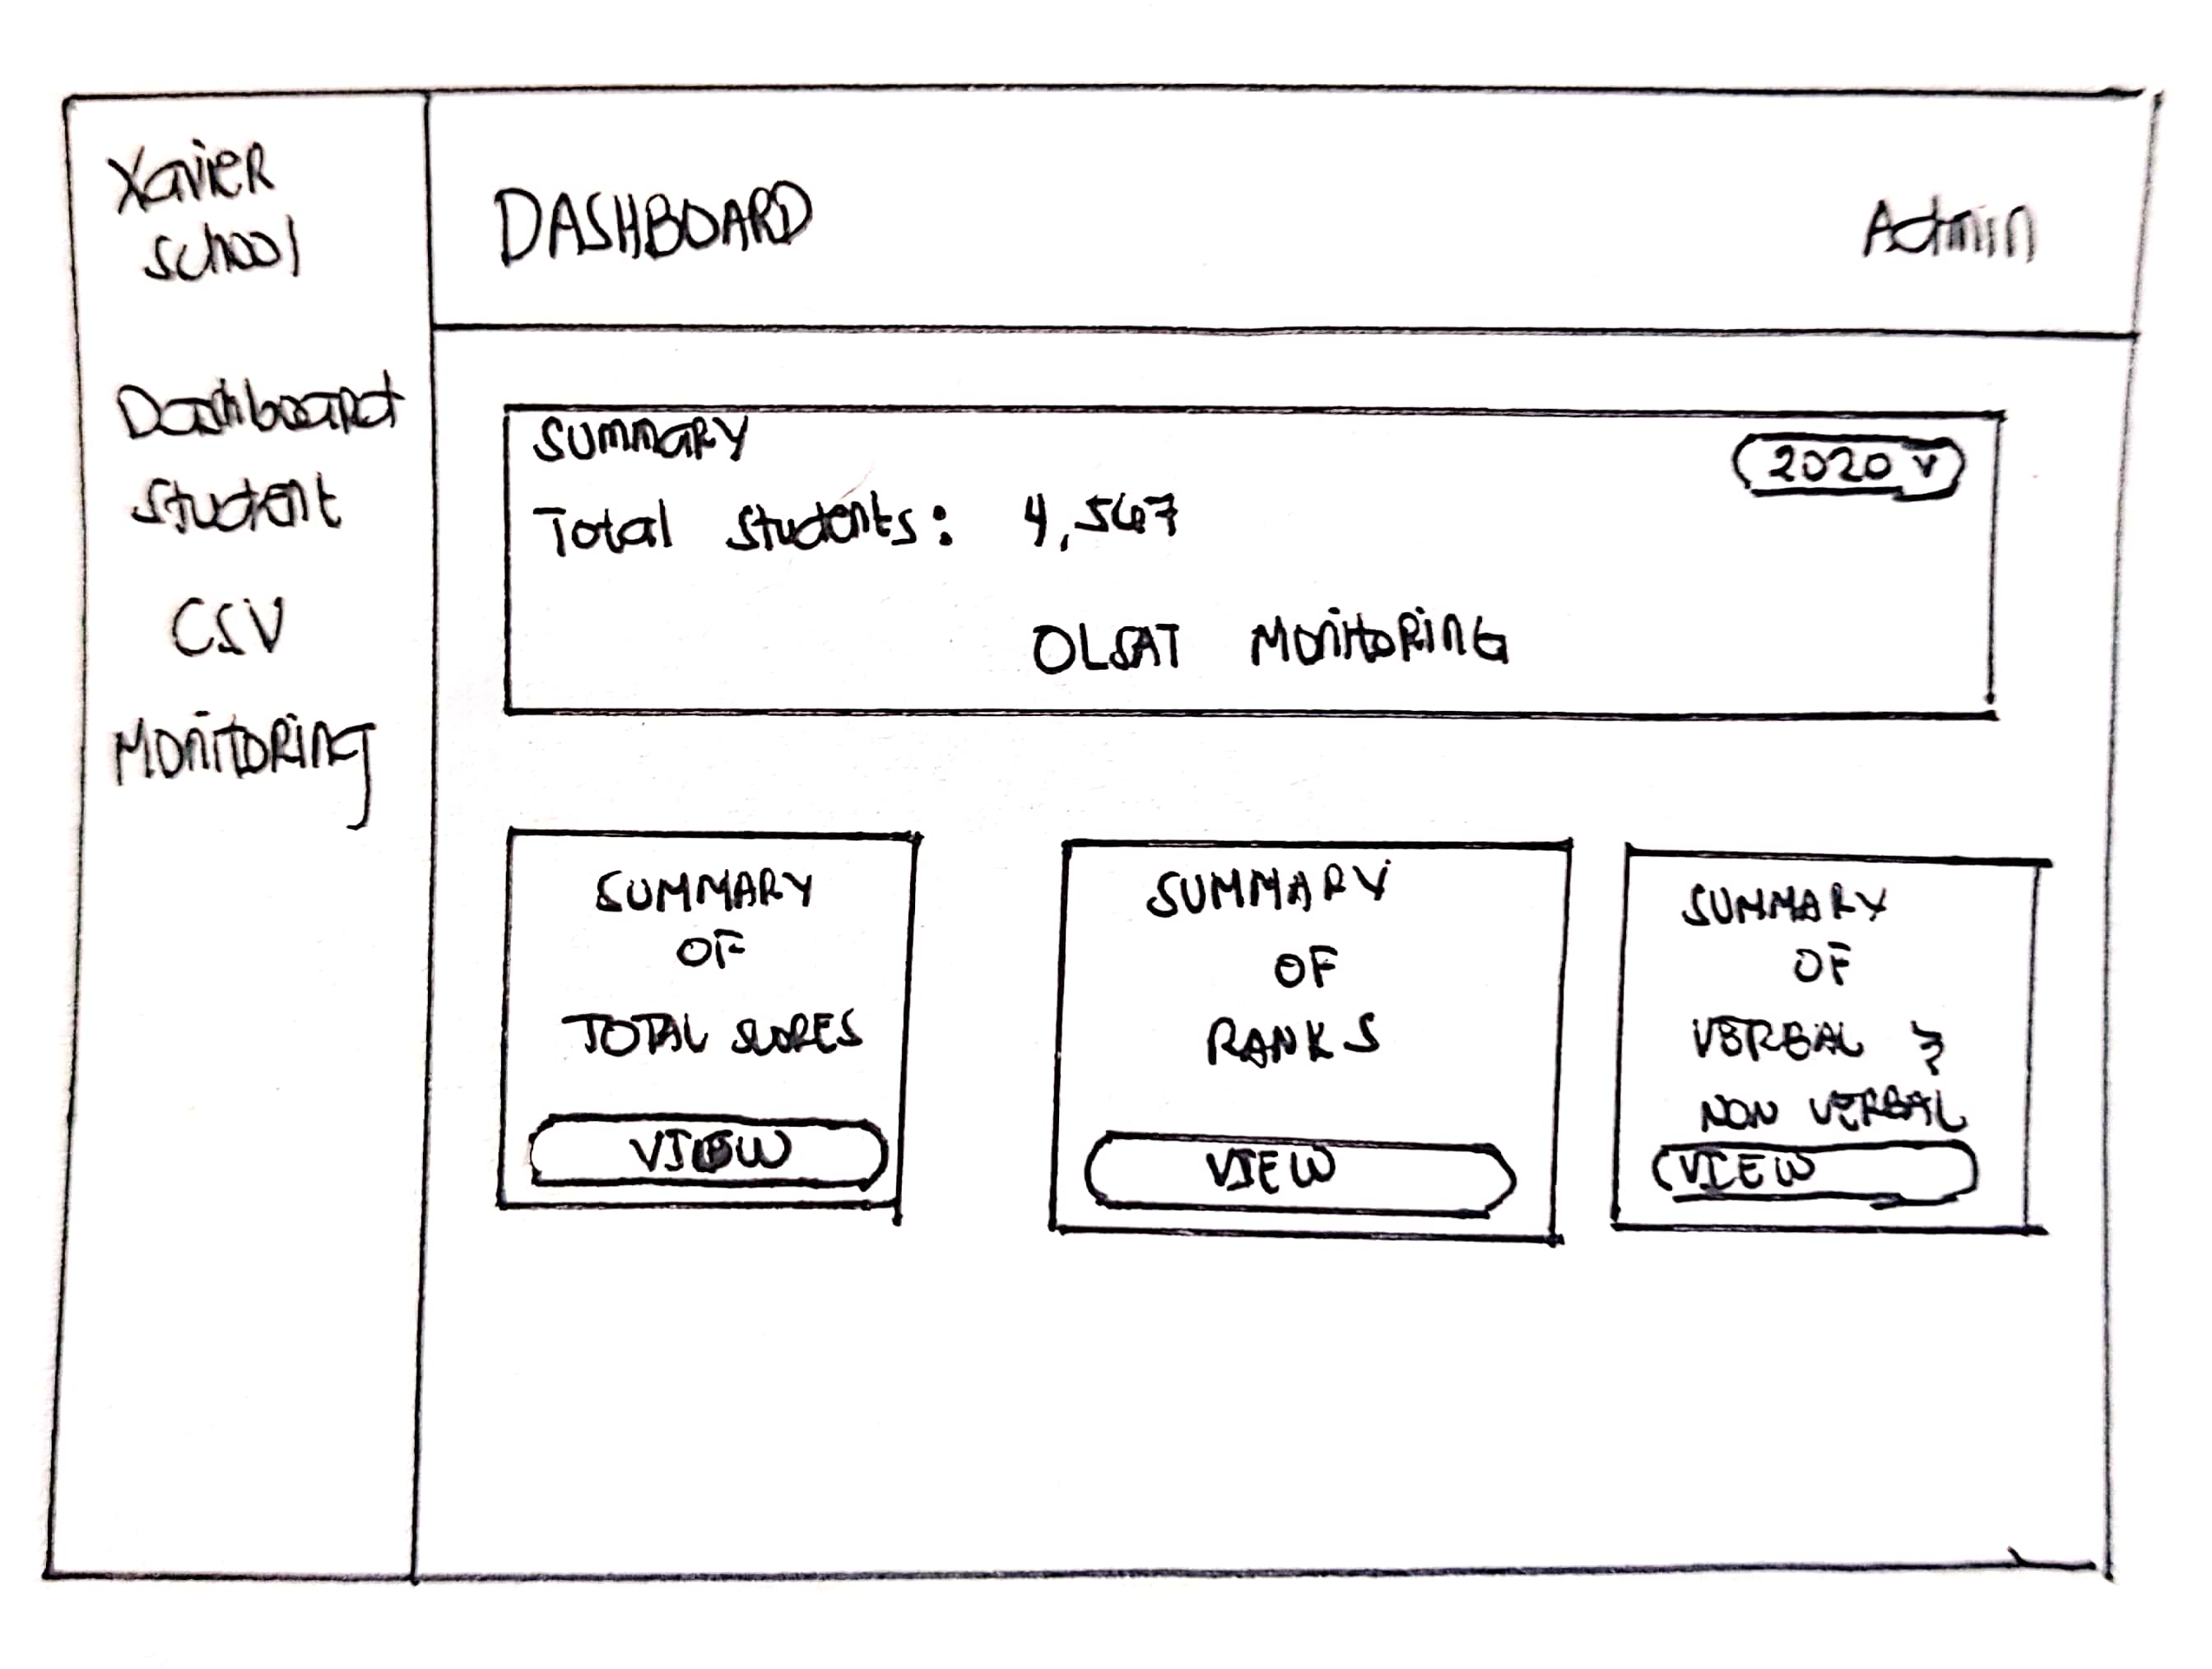
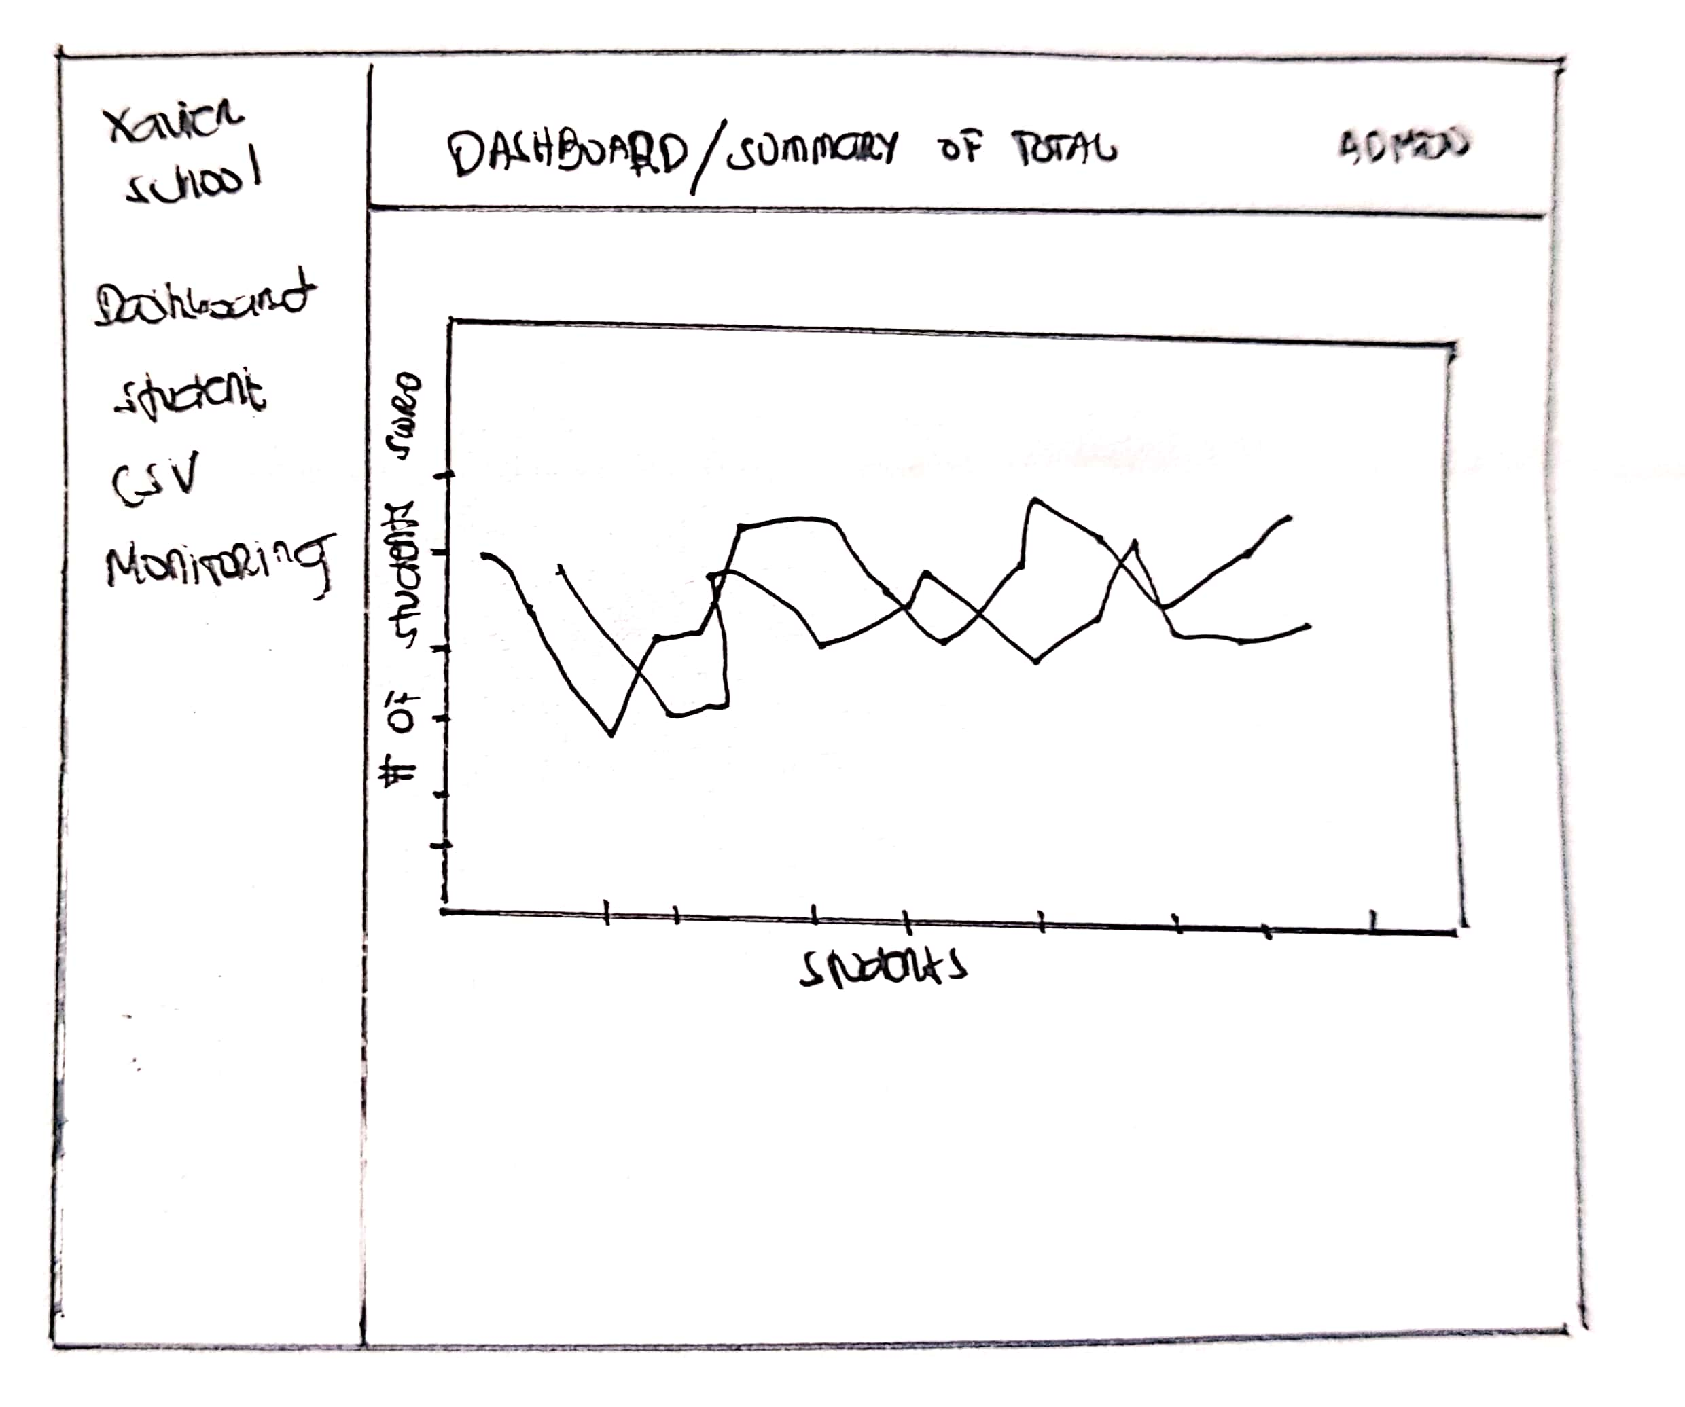
DASHBOARD

Slide 4
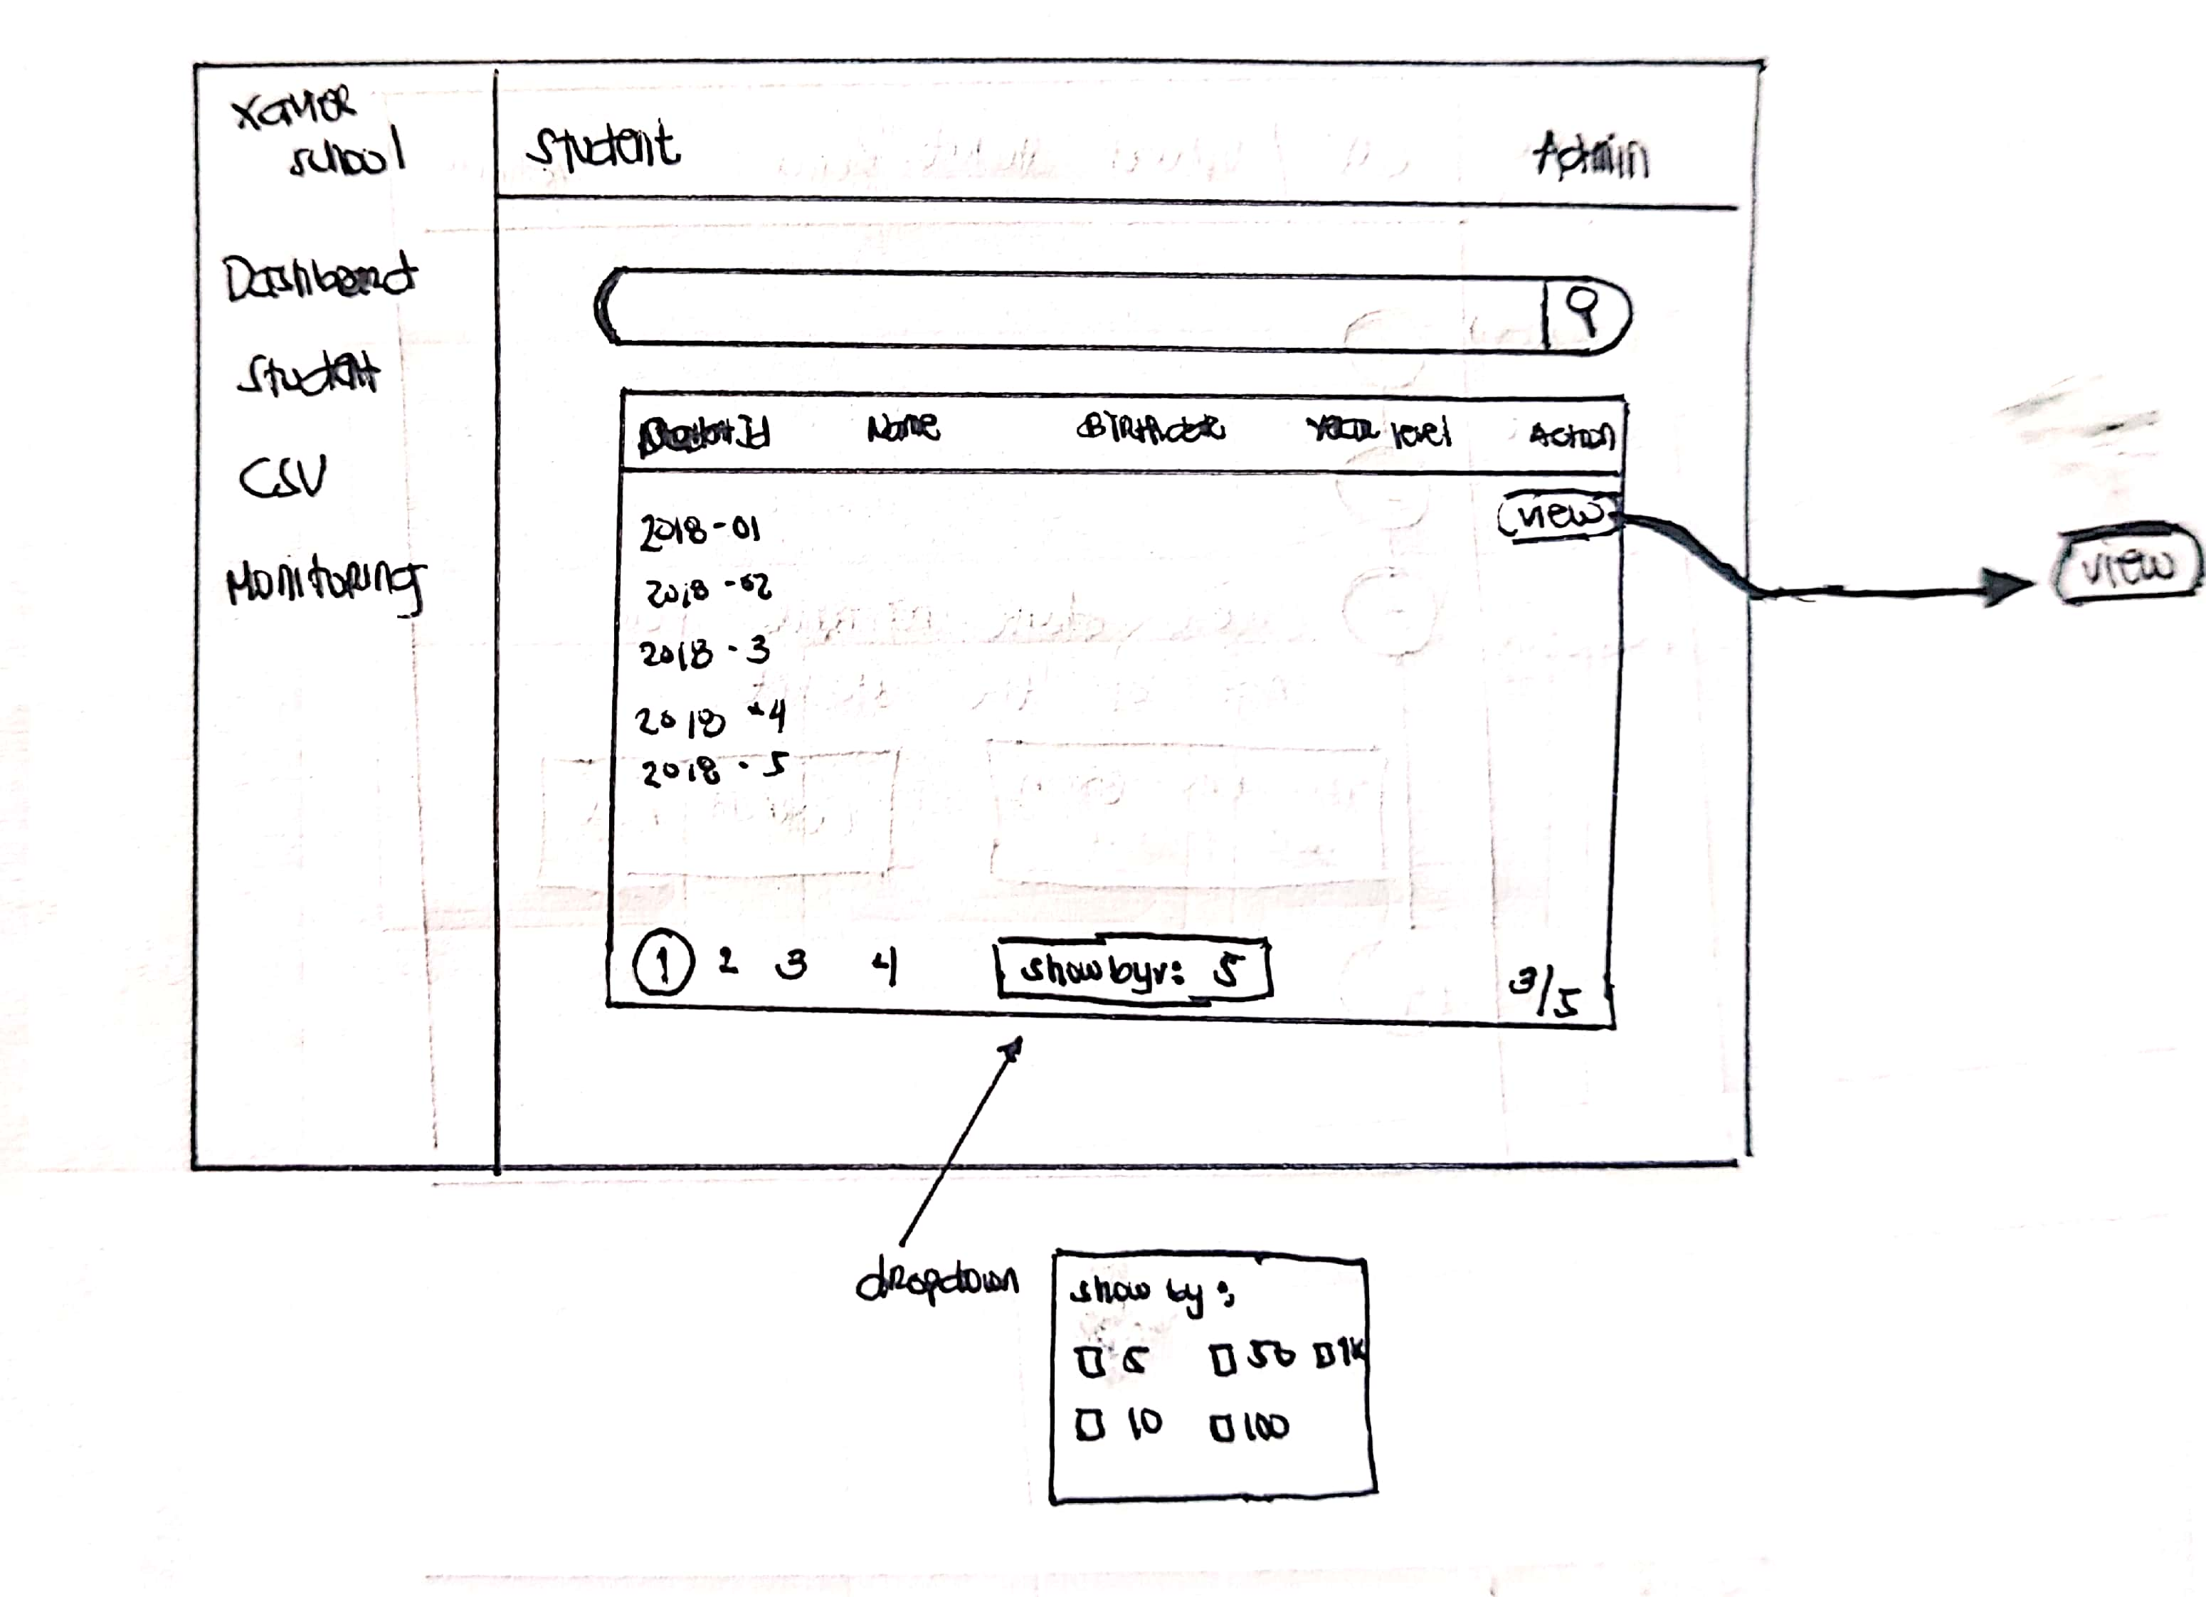
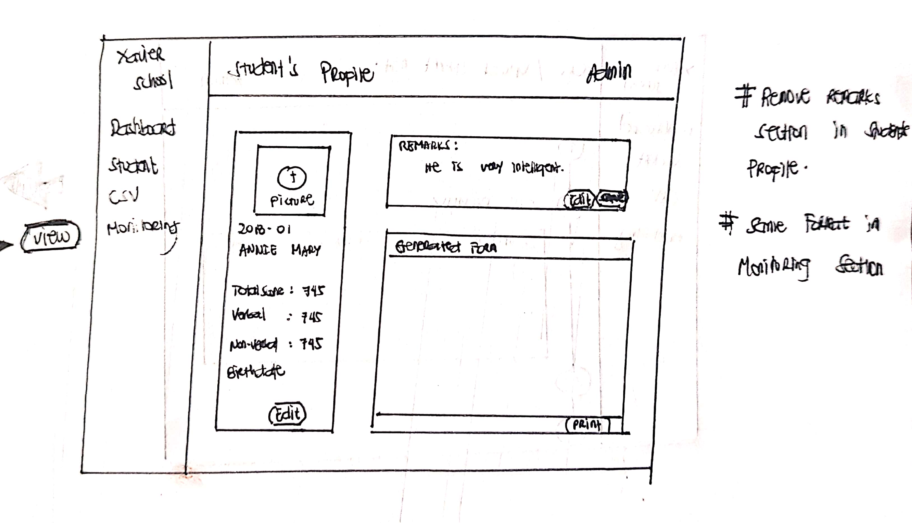
Student’s section

Slide 5
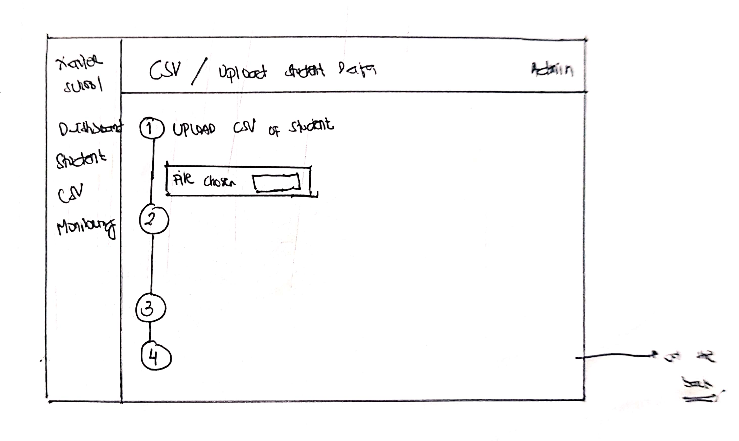
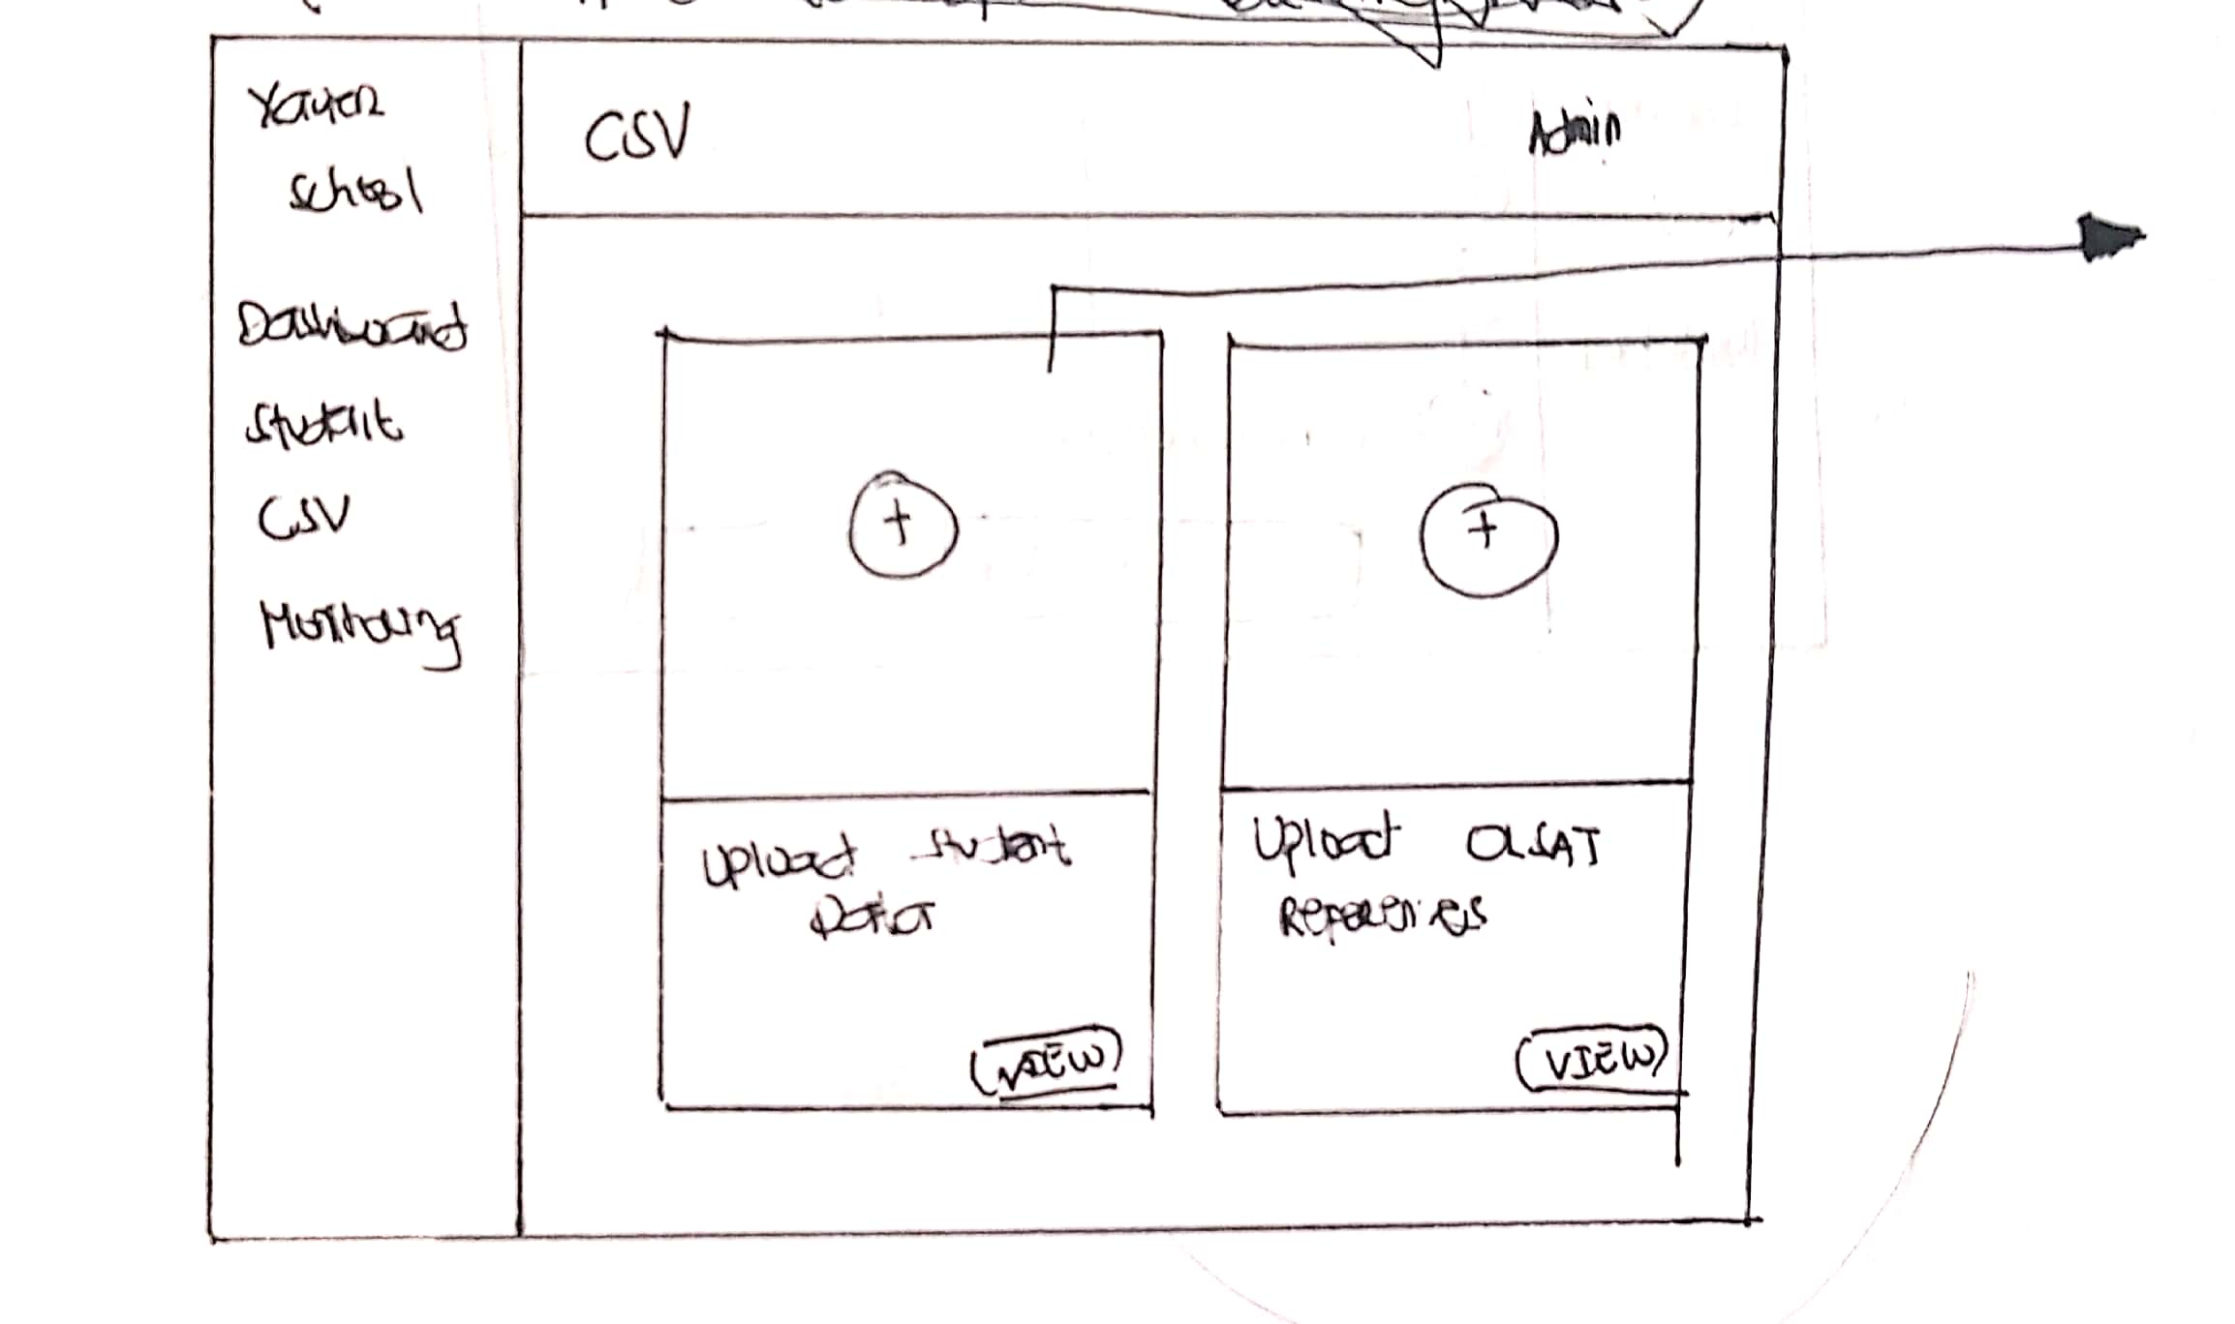
Uploading csv file

Slide 6
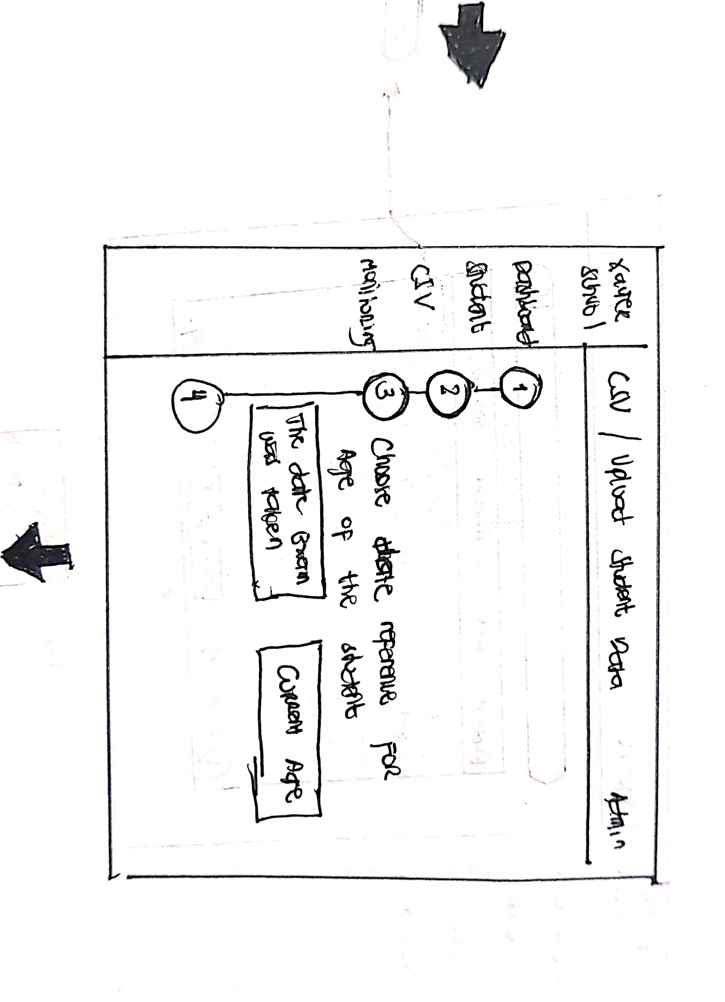
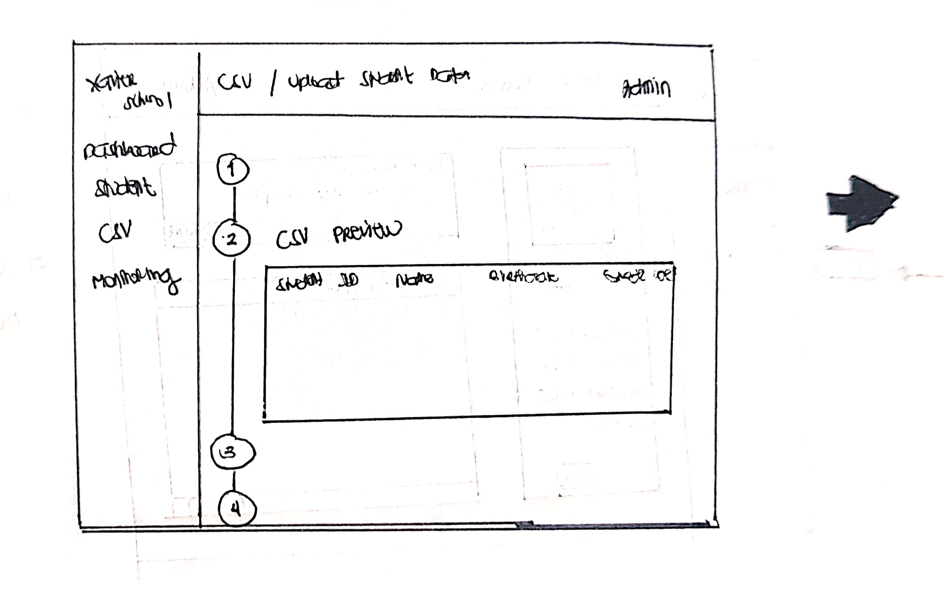
Uploading csv file

Slide 7
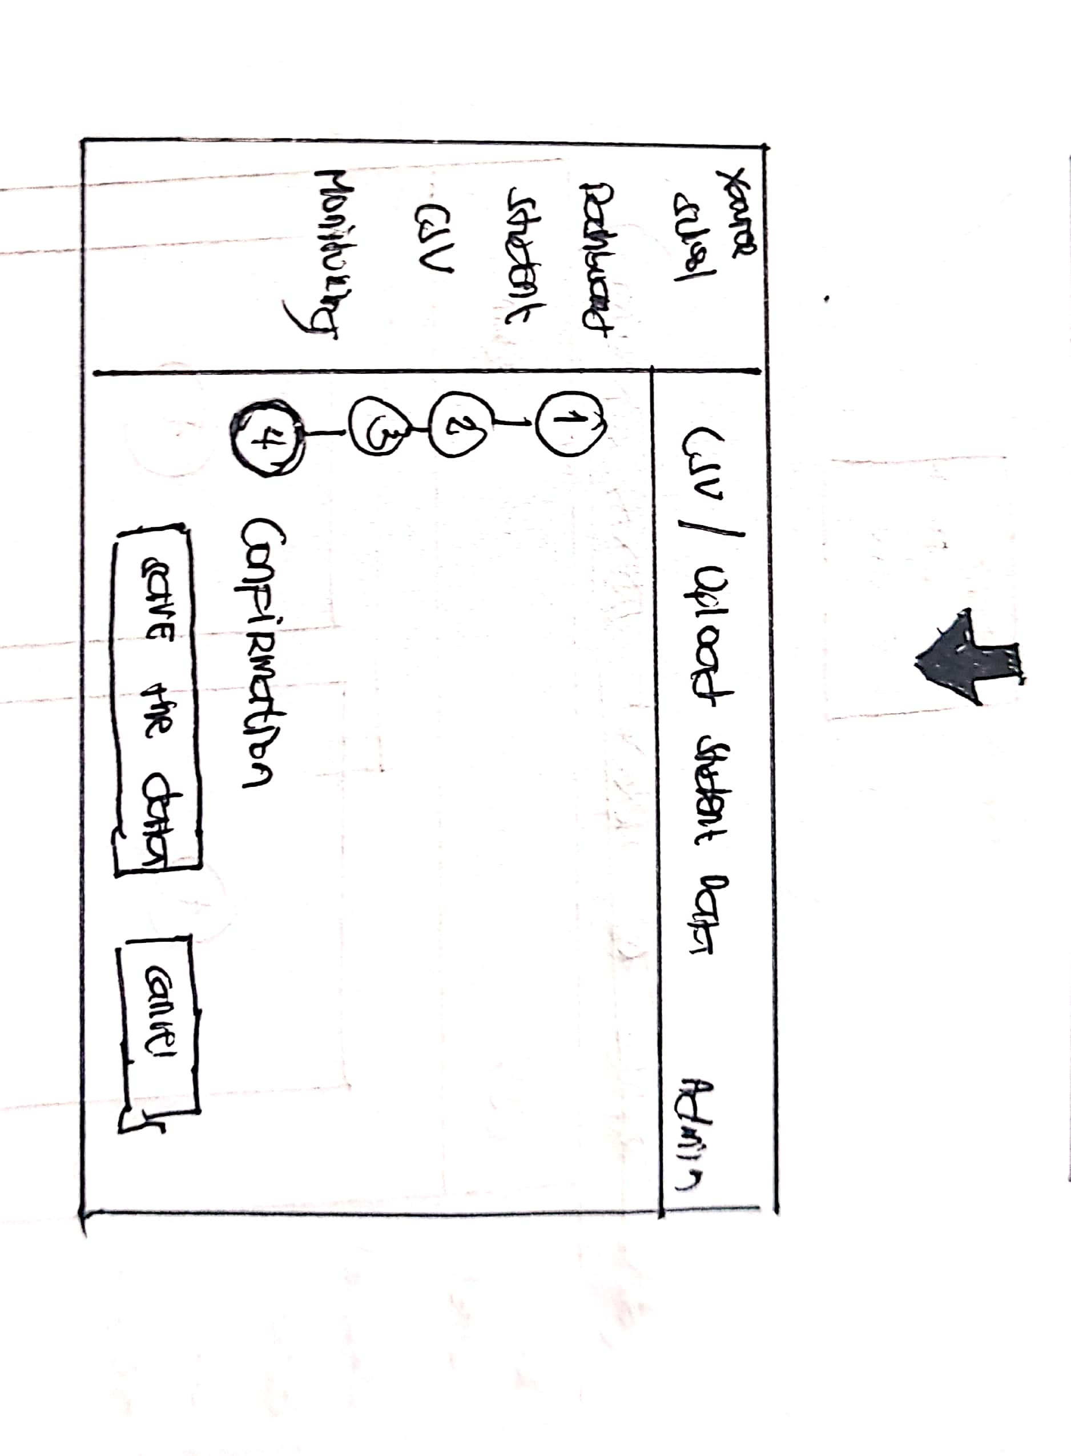
Uploading csv file for student data

Slide 8
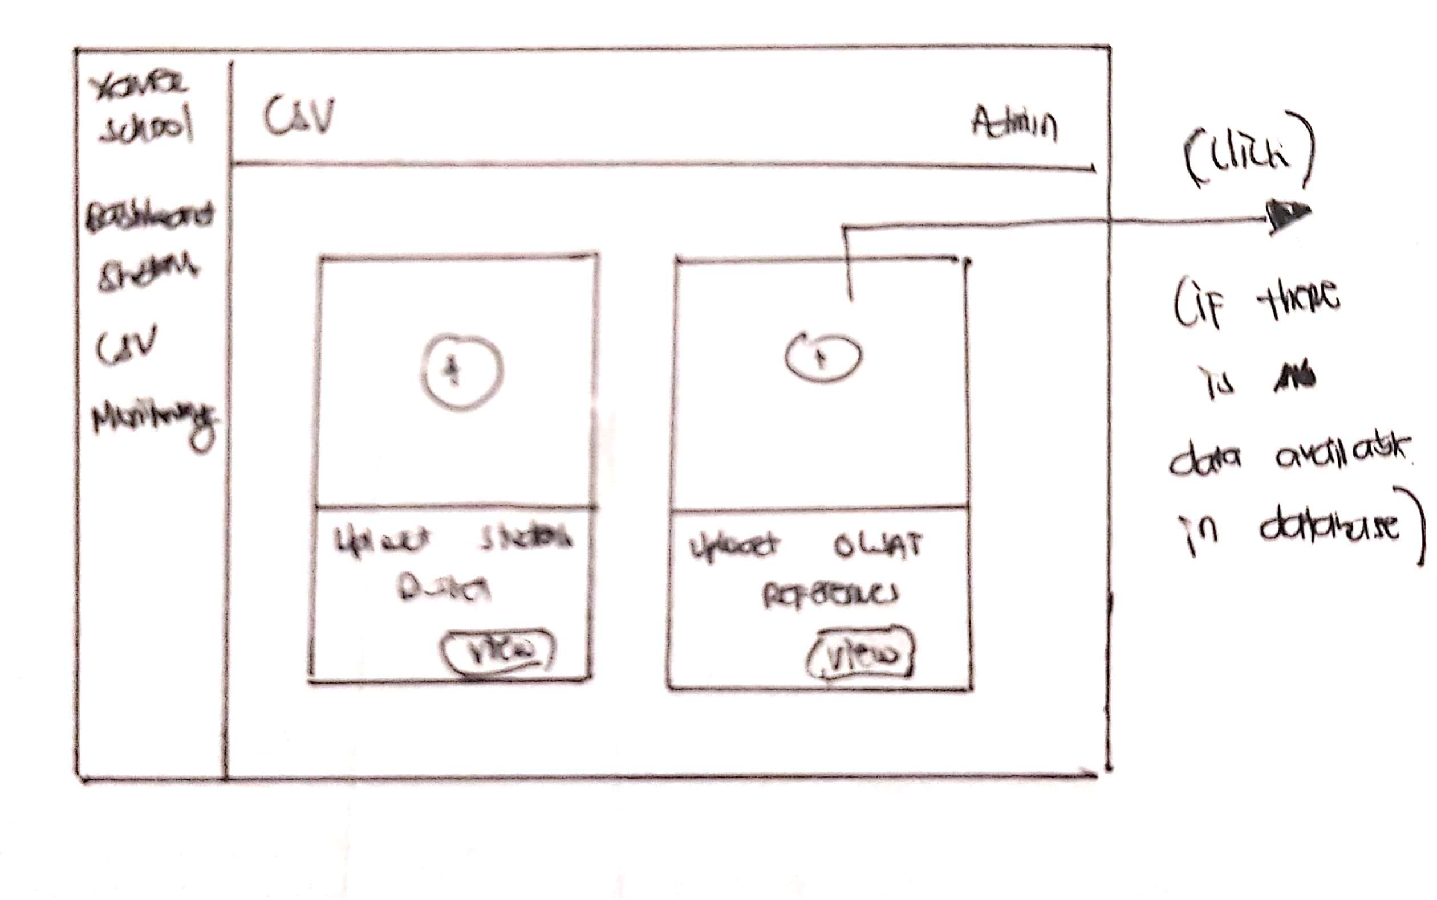
Uploading csv file for olsat reference

Slide 9
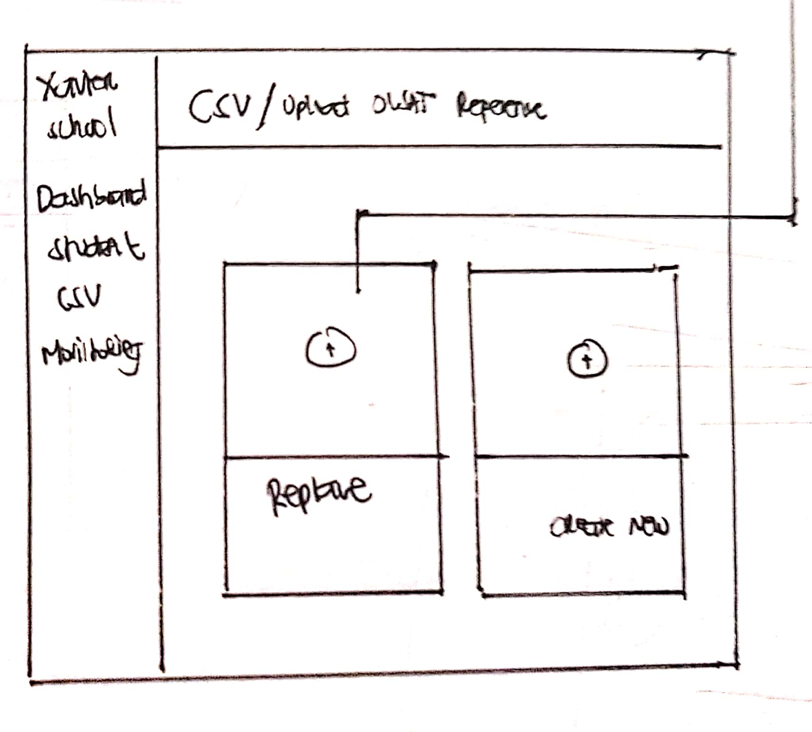
Uploading csv file for olsat reference

Slide 10
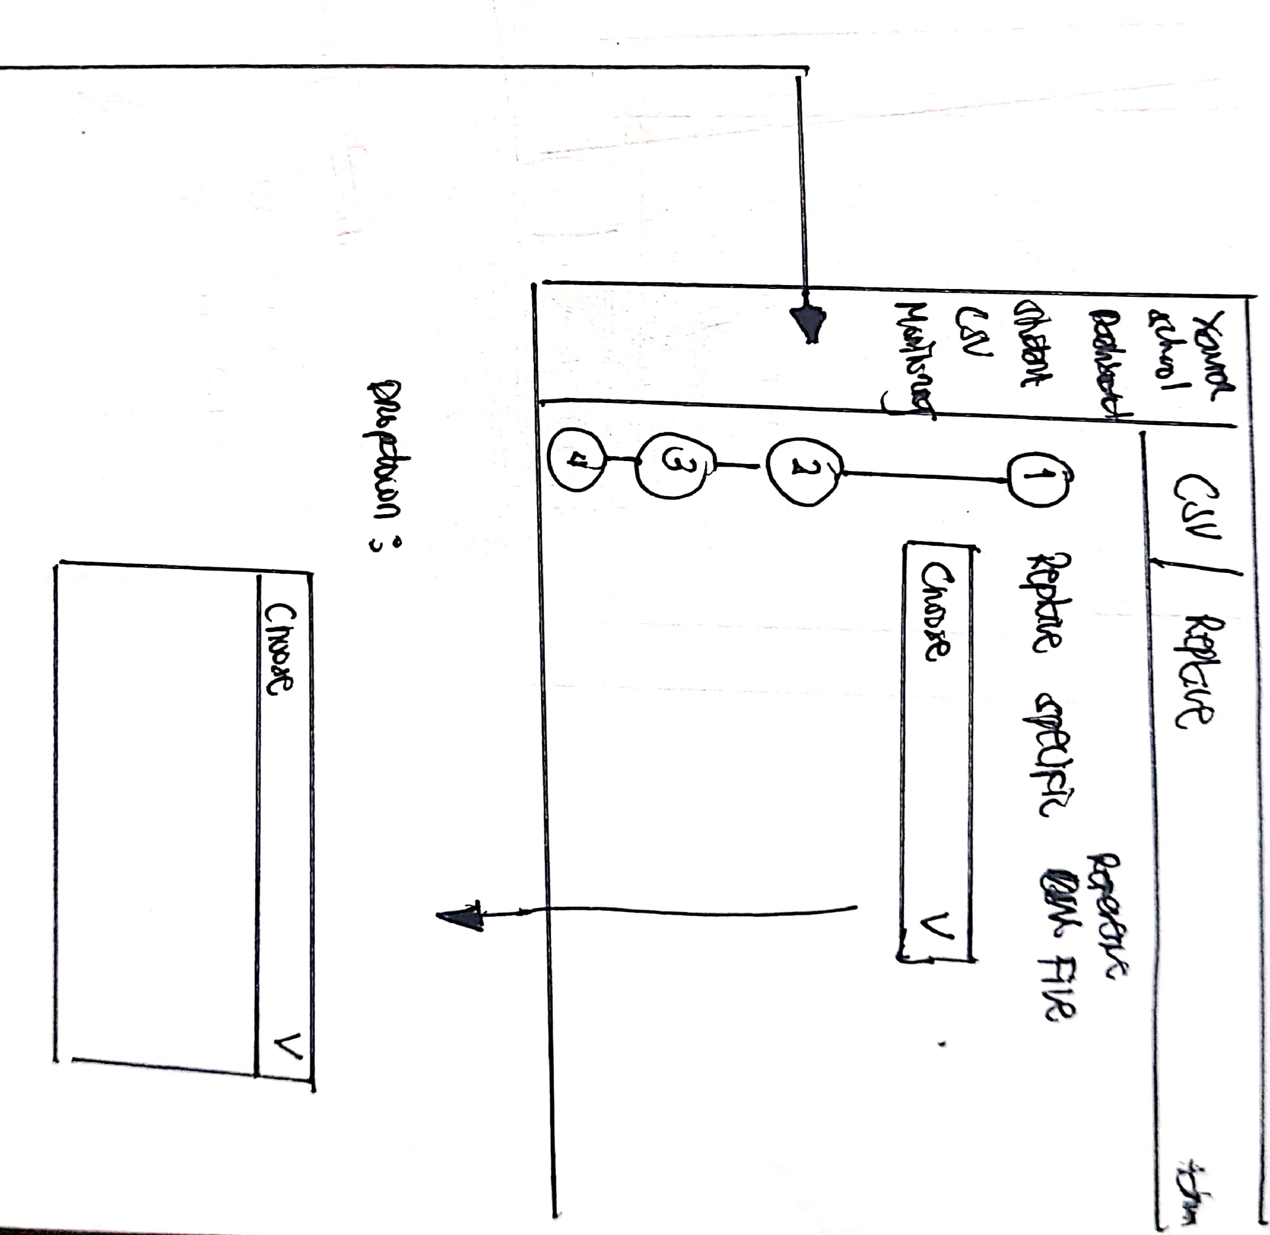
Uploading csv file for olsat reference

Slide 11
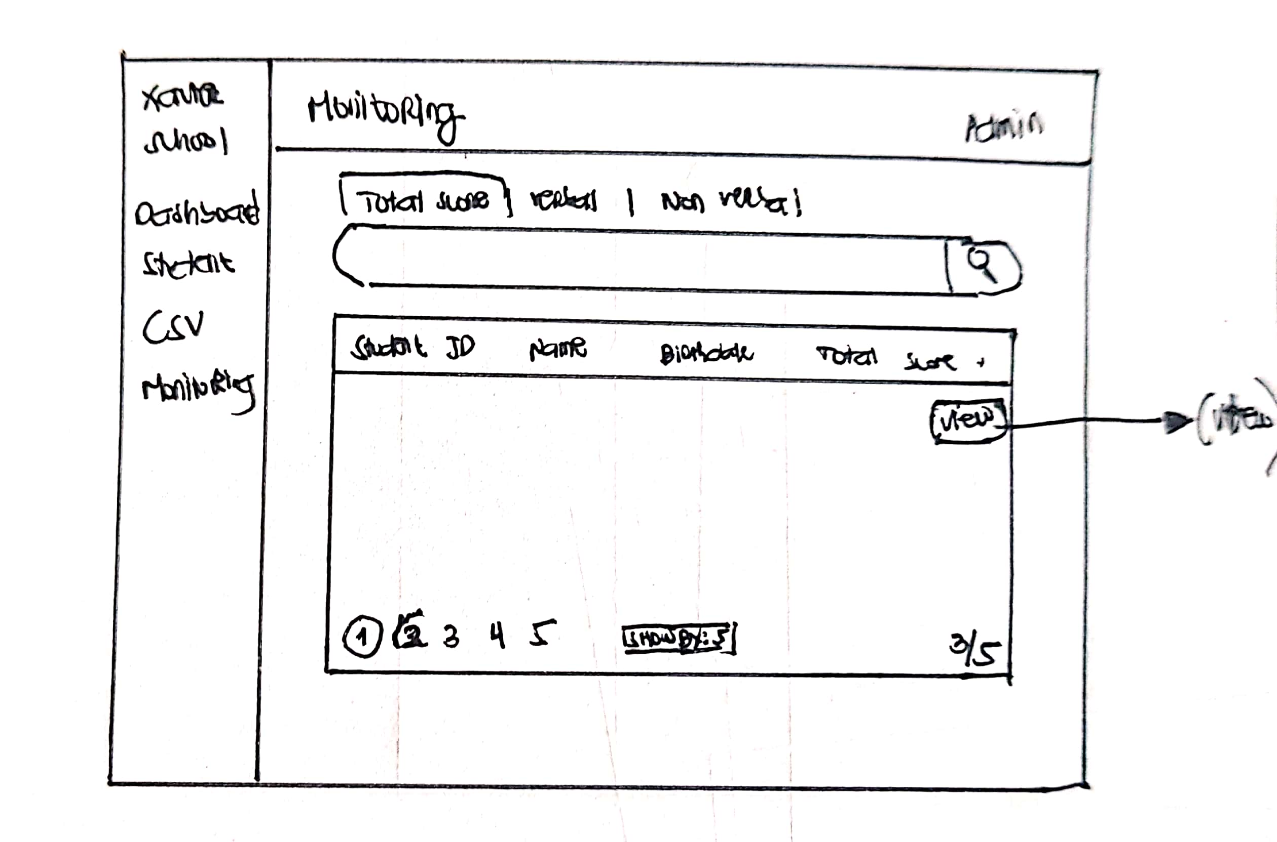
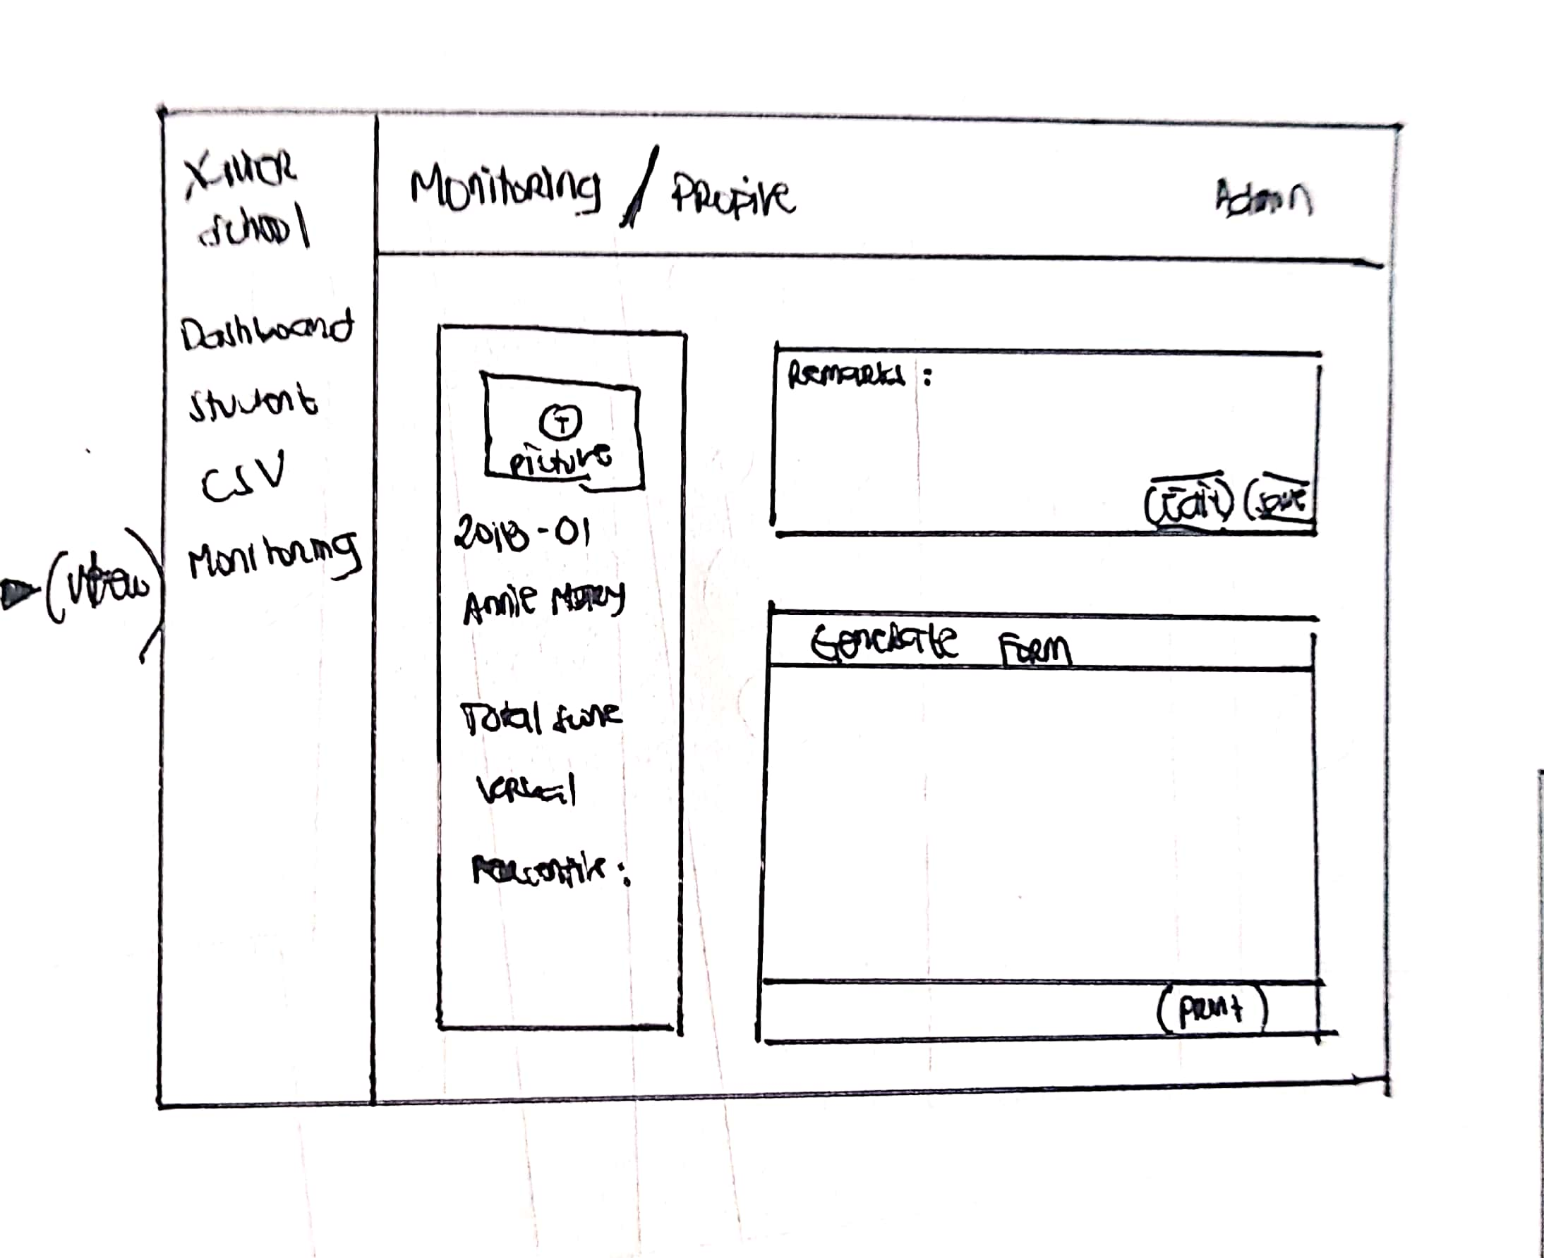
Monitoring section

Slide 12

Thank You

